Slide 1


Analyzing key metrics related to Disney Movies
By:
Debolina Sasmal
Amy Yi
Abdirahman Hussein

Slide 2
TOPICS COVERED
Business Problem and CRISP-DM
Data Wrangling
Exploratory Data Analysis
Regression models
Prediction using the Regression Models
Managerial Conclusion

Slide 3
Business Problem

Slide 4
DATA WRANGLING

Slide 5
EXPLORATORY DATA ANALYSIS

Slide 6
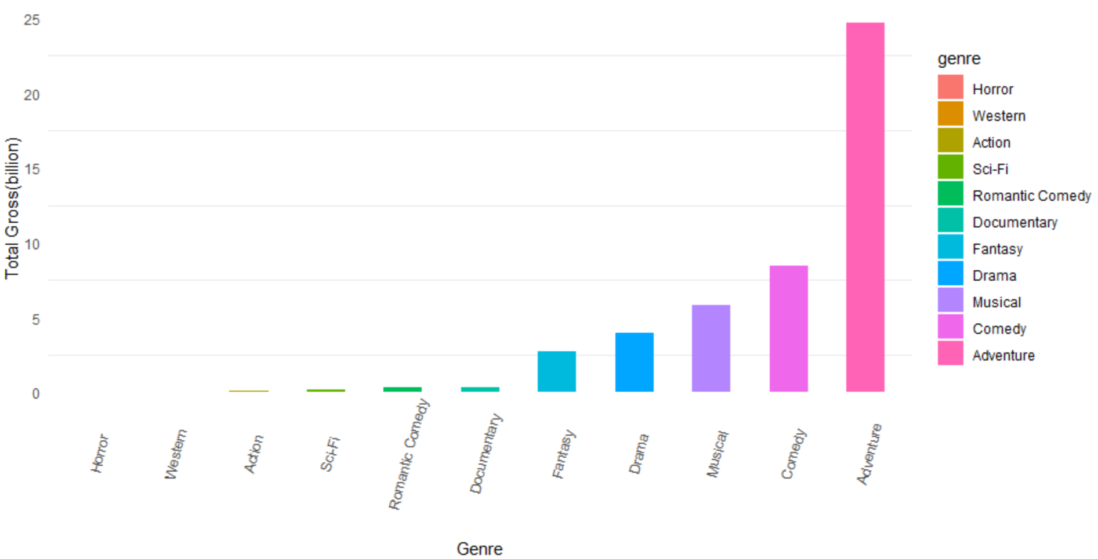
WHICH MOVIE GENRE IS EARNING THE HIGHEST BOX OFFICE REVENUE?

Slide 7
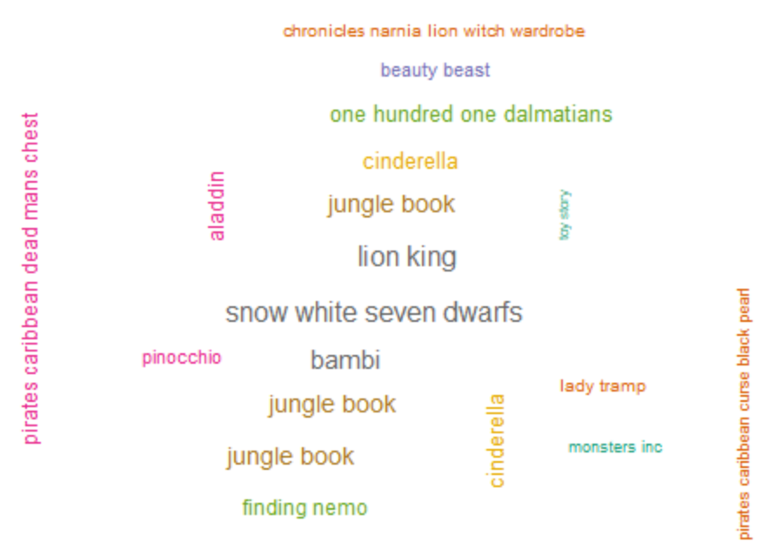
WHICH MOVIE EARNED THE HIGHEST BOX OFFICE EARNINGS?

Slide 8
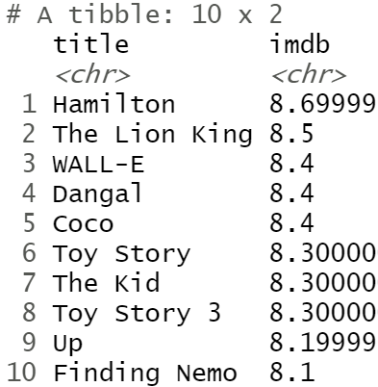
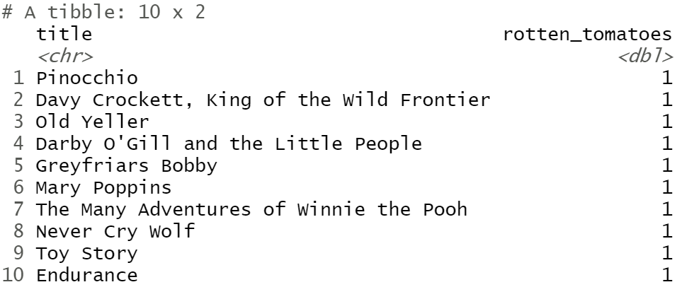
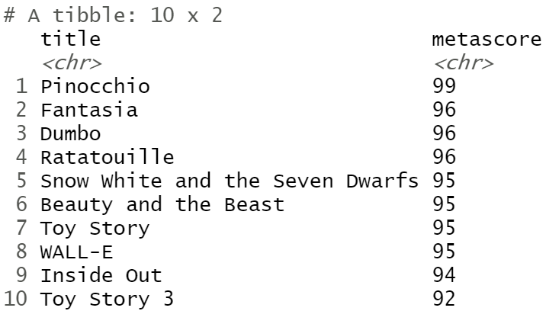
Top 10 movies in terms of IMDB vs. Rotten Tomatoes vs. Metascore
IMDB
ROTTEN TOMATOES
METASCORE

Slide 9
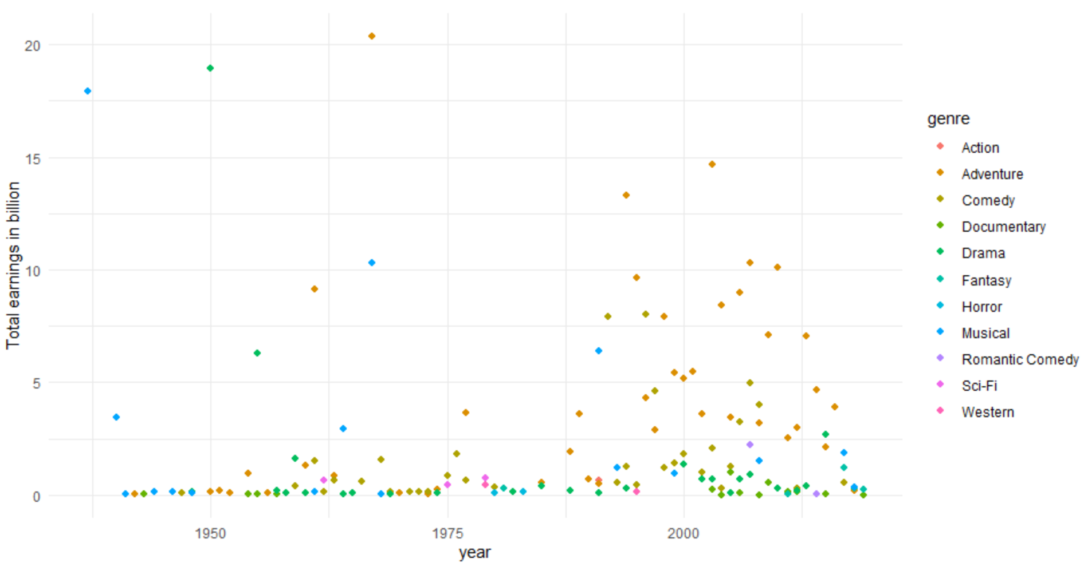
What is the trend of Disney movies over the years?

Slide 10
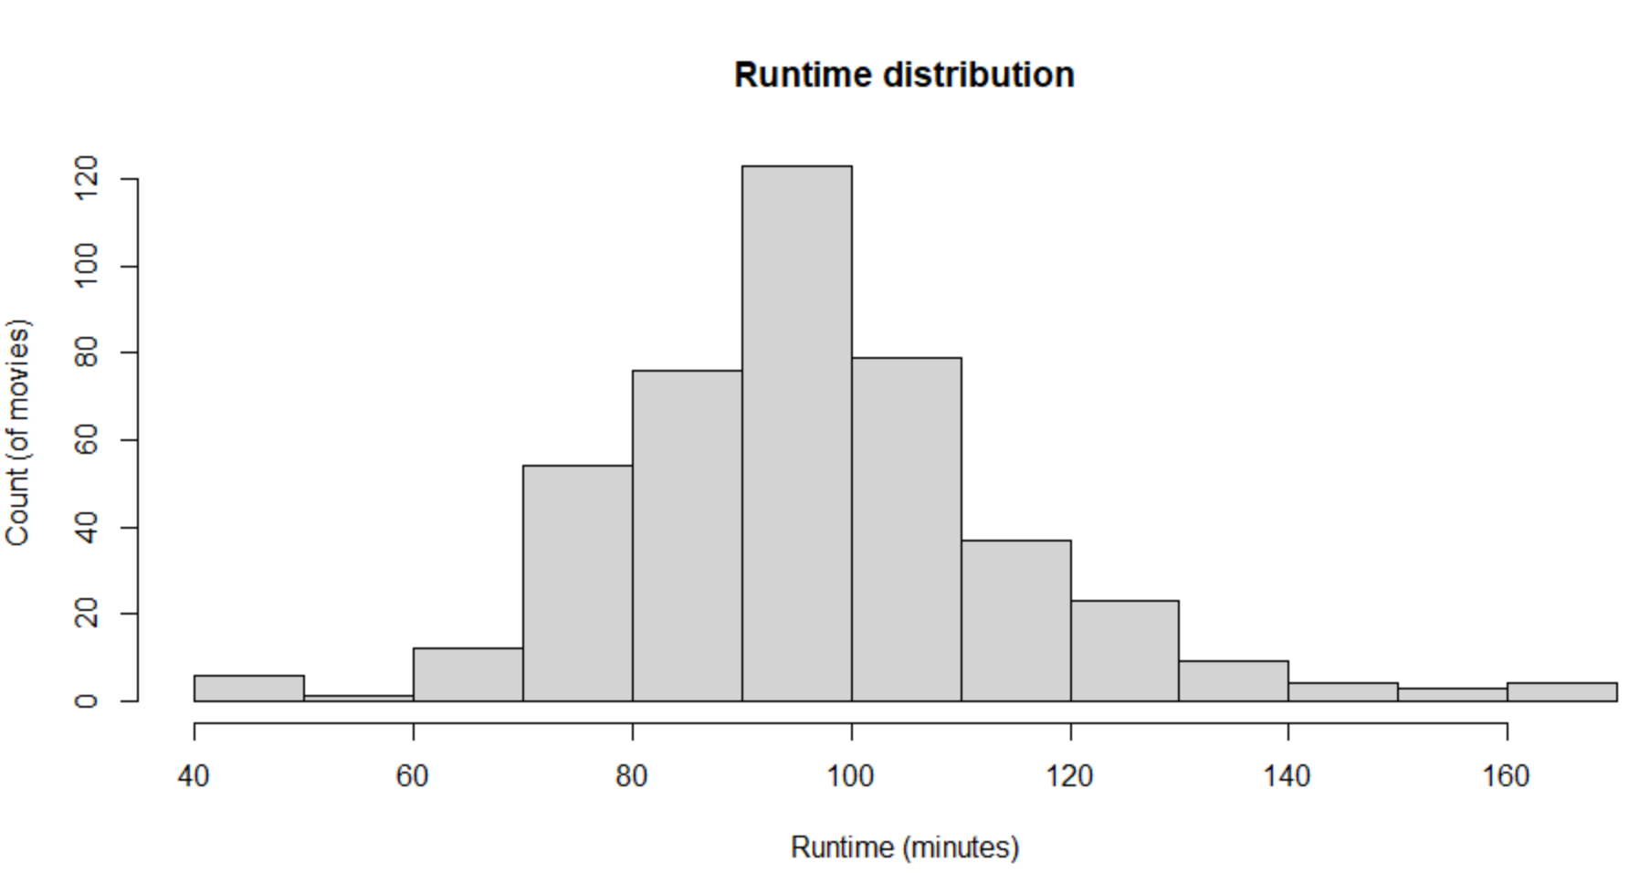
WHAT IS THE RUNTIME OF THE MOVIES?

Slide 11
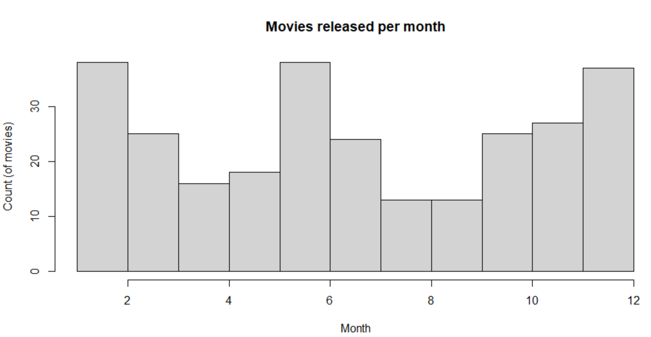
MOVIES ARE USUALLY RELEASED IN WHICH MONTHS?

Slide 12
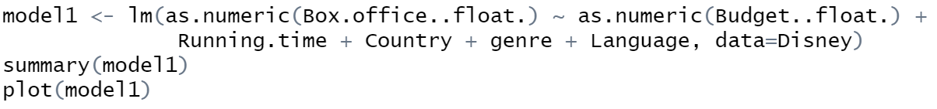
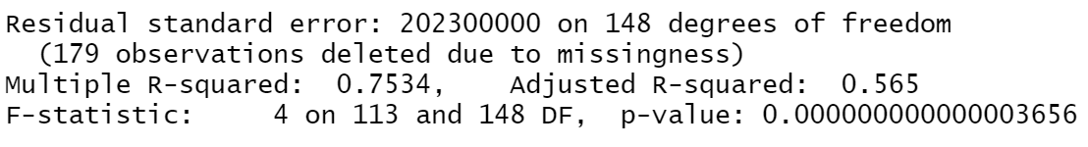
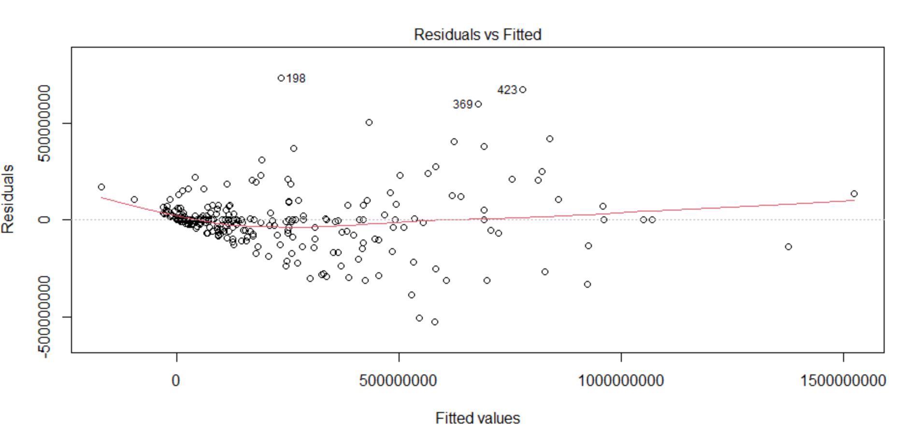
REGRESSION MODEL - 1

Slide 13
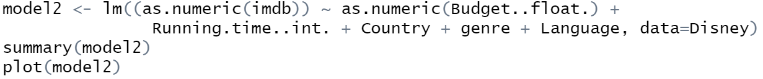
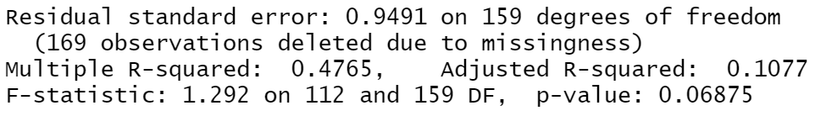
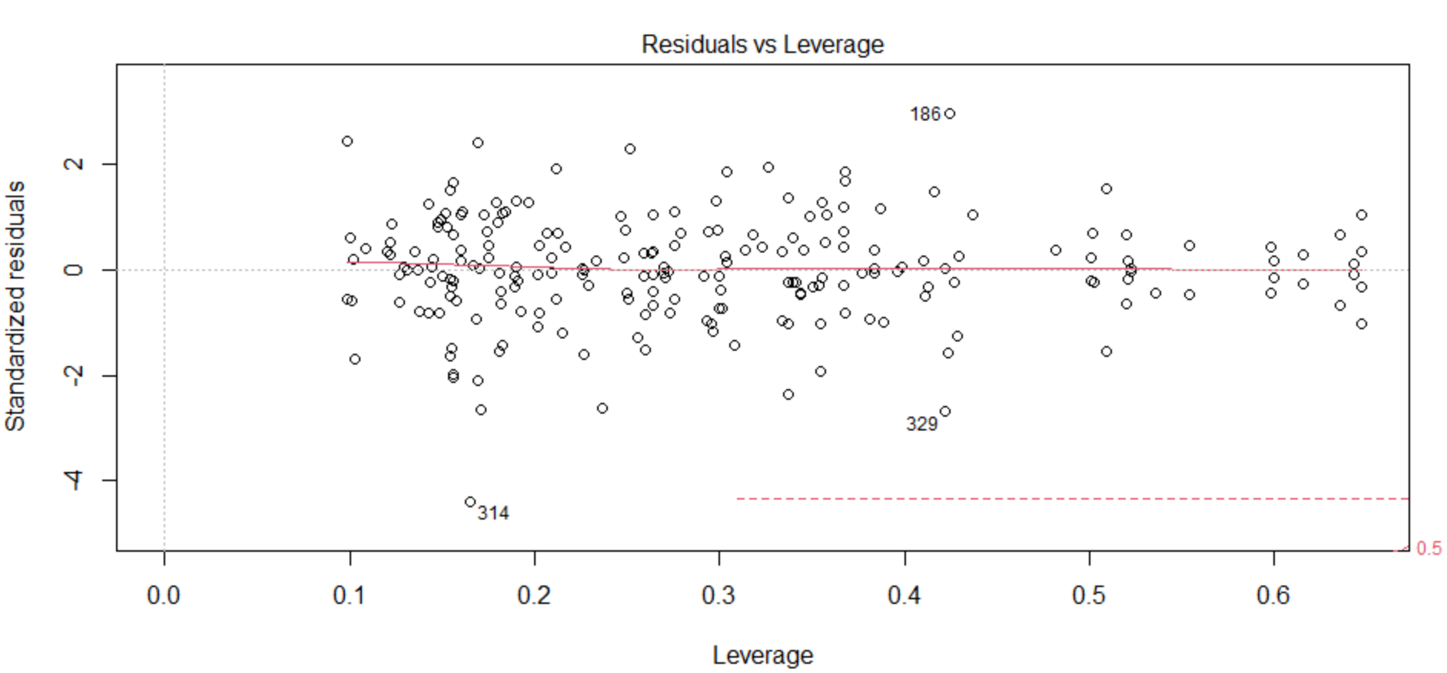
REGRESSION MODEL - 2

Slide 14
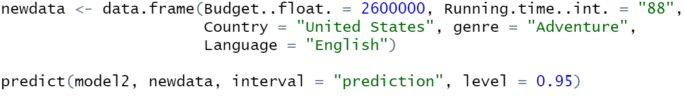

PREDICTION USING MODEL-2
title | Running.time | Country | Language | genre | Budget..float. | imdb
Pinocchio | 88 | United States | English | Adventure | 2600000 | 7.4
Output:

Slide 15
MANEGERIAL CONCLUSIONS

